Slide 1
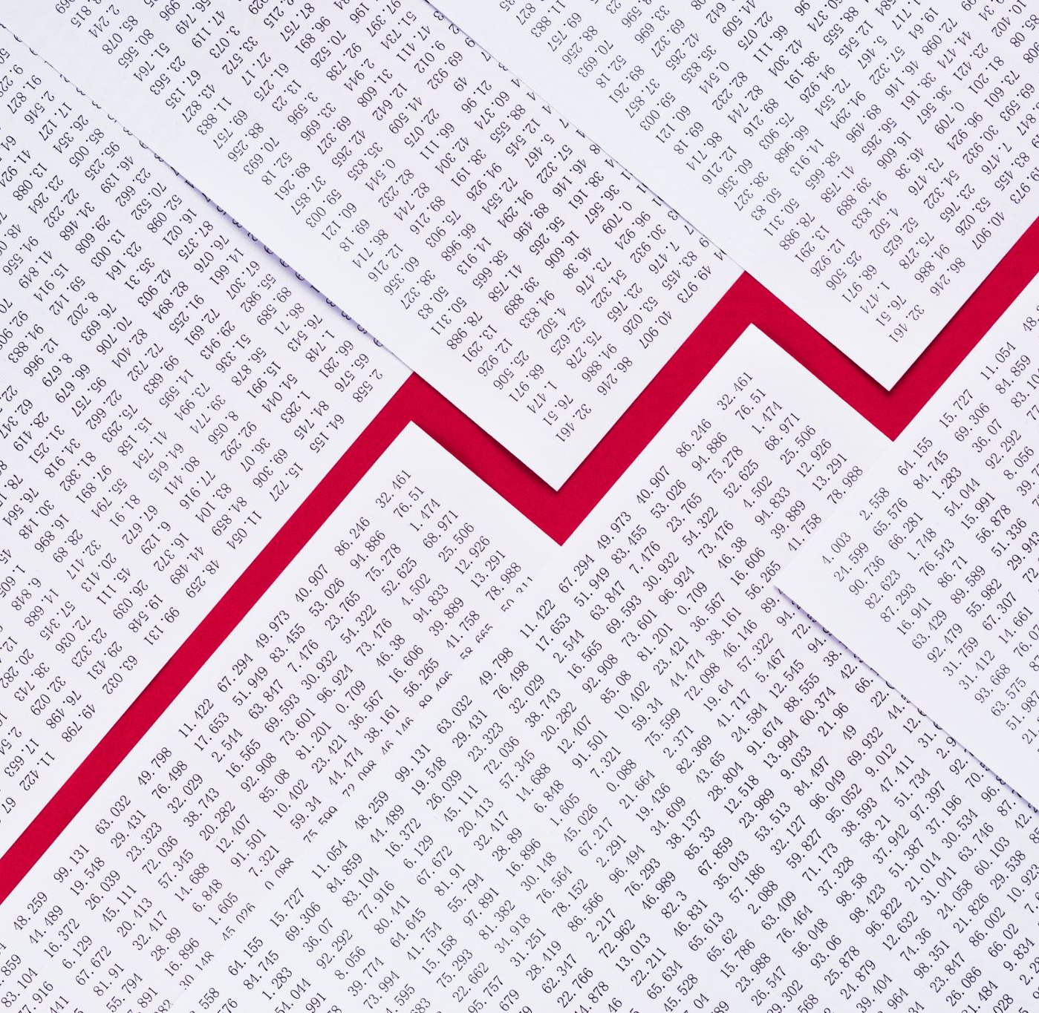

Company Bankruptcy Prediction Avinash Alapati DSC630- T302 Predictive Analytics

Slide 2
Introduction
With Recession around the corner and more layoffs in the market. I was researching on what metrics the companies/organizations go bankrupt.
Good bankruptcy prediction is important for any financial institution to make lending decisions to firms. Some of the co-corporate terminologies which will help identify bankruptcy predictions are Net Income to Total Assets, Interest Coverage Ratio, Cash Flow to Liability, Retained Earnings to Total Assets, Total Asset Growth Rate, and Operating Profit Rate.
The most important questions I wanted to answer are “Relationship between Bankruptcy event and Net income to total assets”
“Relationship between Bankruptcy event to Total Assets,” “Relationship between Bankruptcy event to Total Assets Growth Rate”

Slide 3
Data Set and Preparation
Data set source selection: https://www.kaggle.com/code/jiunkailee/company-bankruptcy-prediction-dt-rf-knn-nn/data
Preparing the Data: remove NA values and selecting important variables related to bankruptcy from the original data

Slide 4
Models used for Evaluation
Random Forest, Decision Tree Classifier and K Neighbors Classifier to check on Test and Train data sets.
K Neighbors has the most accurate prediction with accuracy of test set reaching 75% so I will be proceeding with K Neighbors for Deployment
Random Forest has accuracy of 60%
Decision Tree has test accuracy of 67%

Slide 5

Results Analysis
Net Income to Total Assets growth will decrease bankruptcy chance
Retained earnings to Total Assests will decrease bankruptcy chance
After Tax net interest rate has direct impact on bankruptcy event.
There is no straightforward relationship between Bankrupt and Total Assests growth rate
There is no straightforward relationship between Bankrupt and Total Assests growth rate

Slide 6
Reference Links
https://www.sciencedirect.com/science/article/abs/pii/S0377221716000412
Kaggle Data Sources:
https://www.kaggle.com/code/jiunkailee/company-bankruptcy-prediction-dt-rf-knn-nn/data
Additional Data Source:
https://www.kaggle.com/code/edacebeci/predict-bankruptcy/data
https://scholarworks.lib.csusb.edu/cgi/viewcontent.cgi?article=5256&context=etd-project

